Slide 1
2017 Build Session
2017 Game Animation
Ann Arbor #23
“Yo-Yo Bot”
(Ann Arbor #28)
Marysville Final #3
My Robot
Notes:
Before we start.
Play videos – with sound if we can arrange it? Before meeting
BRING EXTERNAL SPEAKERS

Slide 2


Truck Town Thunder Robotics
Team 68
F.I.R.S.T.
Brandon/Holly
High School Robotics
Team
Notes:
Both of us
Thank you all for coming today. My name is Mrs. Davis - and Mr. Fenn - and we are the Team Co-Leaders for T3. This presentation will give you an idea of some of the specifics of the Truck Town Thunder Robotics Program. We will have spots along the way for questions in order to for this presentation to move along quickly. If you are unable to get your questions answered today feel free to email us anytime at debluvs2teach@gmail.com or gary.r.fenn@gm.com.
Hi everyone

Slide 3
Agenda
Welcome
Safety
What is FRC?
T3 History
Team Organization
Code of Conduct
Community Service
Business Details
Turkey Legs
Communications
Split
  Students to Team Building
  Parents here for PRO
Calendar
Close

Slide 4
Team Co-Leaders
New team leaders for 2017-18…
Debbie Davis
and
Gary Fenn

Slide 5
Agenda
Welcome
Safety
What is FRC?
T3 History
Team Organization
Code of Conduct
Community Service
Business Details
Turkey Legs
Communications
Split
  Students to Team Building
  Parents here for PRO
Calendar
Close

Slide 6
Safety
is the Primary Concern
at ALL Times!!
We want each team member to go home in the same condition as when they arrived.

Slide 7
Mandatory Dress Code
Pants at all times during the school year
Closed toe shoes
No loose clothing or hair
Safety Glasses at all times in the shop
Competitions:
  Students are expected to wear team uniform at all times
Notes:
7
We will be looking into using the ITEC center for the entire day. If not, we will spend the afternoon in the shop brainstorming. After Kickoff, the team will have approximately 6 weeks to build a highly competitive robot. This is an enormous undertaking and will take the cooperation from all aspects of the team, Advisors, Mentors, Student Team Members, Parents, etc.

Slide 8
Questions so far?

Slide 9
Agenda
Welcome
Safety
What is FRC?
T3 History
Team Organization
Code of Conduct
Community Service
Business Details
Turkey Legs
Communications
Split
  Students to Team Building
  Parents here for PRO
Calendar
Close

Slide 10
Truck Town Thunder
2017 Chairman’s Video

Slide 11

What is FIRST?
For Inspiration and Recognition of Science and Technology
“The excitement of sport, the rigors of science”
“The varsity sport of the mind”
Notes:
11
Gary
Under strict rules, limited resources, and the guidance of volunteer mentors including engineers, teachers, business professionals, parents, alumni and more, teams of 25+ students have just six weeks to build and program robots to perform challenging tasks against a field of competitors. They must also raise funds, design a team "brand," hone teamwork skills, and perform community outreach. In addition to learning valuable STEM and life skills, participants are eligible to apply for $50+ million in college scholarships.
https://youtu.be/GZXngCu99rs and https://youtu.be/UdVIv8nPkgY
"FIRST is more than robots. The robots are a vehicle for students to learn life skills. Kids often come in not knowing what to expect - of te program no themselves. They leave, even ater the first season, with a vision, with confidence, and with a sense that they can create their own future."Dean Kamen
More at https://www.firstinspires.org

Slide 12
About T3
Team Vision and Mission
Recognition and Leadership
  Team
  School
  Community
Gracious Professionalism
  https://www.youtube.com/watch?v=PCGsLAyrck4
Co-opertition
Notes:
12
Gary?
Team vision and mission:
OUR VISION: FIRST Team 68, Truck Town Thunder’s overall goal is to build a passionate team that encourages students to absorb new knowledge from dedicated team members while relentlessly having fun.
and
OUR MISSION: “To inspire peers to be more excited about science, engineering, and technology by engaging them in a hands-on mentor guided life-changing journey that prepares everyone for the future.”
The team is deep with experience from years of FIRST Participation. All of the mentors and advisors are dedicated to continuous improvement of the T3 Robotics
Gracious Professionalism: a way of doing things that encourages high-quality work, emphasizes the value of others, and respects individuals and the community.
Co-opertition: is displaying unqualified kindness and respect in the face of fierce competition. Coopertition is founded on the concept and a philosophy that teams can and should help and cooperate with each other even as they compete. Coopertition involves learning from teammates. It is teaching teammates. It is learning from Mentors. And it is managing and being managed. Coopertition means competing always, but assisting and enabling others when you can.

Slide 13
Agenda
Welcome
Safety
What is FRC?
T3 History
Team Organization
Code of Conduct
Community Service
Business Details
Turkey Legs
Communications
Split
  Students to Team Building
  Parents here for PRO
Calendar
Close

Slide 14
T3 History
Team Founded in 1998
  Located at General Motors
  Original Name: Truck Town Terror
  2001: Name Changed to Truck Town Thunder
  2009: Team Moves into Brandon High School
Notes:
14
Gary
We are constantly looking for new mentors to help with the students. A special thank you to all of our parents who have stepped up to spend time with the students. We also have college mentors who have been on the team in the past that come out to continue to promote a program they loved as a team member. This is key to the future of the team.

Slide 15
Team Award Success
Michigan District Level
  Chairman's Award - 6
  Engineering Inspiration Award – 4
  Entrepreneurship Award – 6
  Gracious Professionalism Award - 2
  Industrial Safety Award – 12
  Quality Award - 3
  Industrial Design Award - 1
Regional Level/ State Championship
Chairman’s Award - 4
Judges Award – 6
Imagery – 5
Quality Award – 3
Innovation in Control – 3
Team Spirit – 2
Industrial Design
Entrepreneurship
Creativity
World/National Level
Imagery Award
Quality Award
Notes:
15
Gary
We have been successful

Slide 16
Team Competitive Success
District Level
  District Champions - 5
  District Finalists - 1
Regional/State Championship Level
  Regional Finalists - 5
  Regional Champions - 2
World Level
  Division Champions - 1
  Division Finalists - 2
  World Finalists - 2
  World Champions - 0
Notes:
16

Slide 17
Off – Season Competitive Success
Michigan Advanced Robotics Competition
  Champions – 2 (2012, 2015)
Indiana Robotics Invitational
  Champions – 3 (2009, 2008, 2002)
Kettering Kickoff
  Champions – 4 (2012, 2009, 2003, 2000)
Notes:
With the change in team leadership, we were not able to consider any off-season events this year.

Slide 18
Questions so far?

Slide 19
Agenda
Welcome
Safety
What is FRC?
T3 History
Team Organization
Code of Conduct
Community Service
Business Details
Turkey Legs
Communications
Split
  Students to Team Building
  Parents here for PRO
Calendar
Close

Slide 20
Team Co-Leaders
New team leaders for 2017-18…
Debbie Davis
and
Gary Fenn

Slide 21
Advisors
Dave Smith – Lead Engineer - 19 Years
Gary Fenn – Engineering, Elec/Programming, shop - 12 years
Kellie Determan – Media/Marketing - 6 Years
Notes:
Gary
Many of our past Mentors and Advisors are GM engineers, Machinists, etc. We cannot thank GM enough for their support over the years.
Kelly had a number of personal and professional commitments the last year-plus but is hoping to contribute more the next year…

Slide 22
Mentoring
Professional Mentors
Jason Bobel - Awards
Paul Braun – Mechanical/Engineering Design
Katie Dubiel - Media
Joe Dubiel – Shop
Matt Eckert – Programming/ Project Management
Tim Flickinger – Electrical/Scouting/Strategy
Cindy Hawkins – Safety
Professional Mentors (Cont.)
Dave Ritenburgh – Shop
Sonia Ritenburgh – Uniforms
Brian Schulz – Mechanical
Katherine Stewart – Fundraising
College Mentors
Breeana Oakley
James Wallace
Notes:
22
So we have many mentors – and we can always use more!
We will require that anyone listed officially as a mentor be required to sign up in the FRC VIMS – which has a new name this year – and certify they have reviewed and agreed to follow the FIRST Youth Protection material.
Move these comments to Turkey legs
In order for the team to be able to execute such an excellent fundraiser it is important that we all pitch to make sure it is a success. Truck Town Thunder is also known for giving the MRF any help that we can afford to give without hindering the our job of cooking the Turkey Legs. We have been known to have parents collect money or even drive a Hi-Lo. This is not mandatory but we will help out when needed. The Turkey Leg Fundraiser will be ran by Mr. Fenn or Mr. Dubiel each day. We will also be asking parents to help run Turkey Pads. Though there are many students that are capable of running the pads on their own, it is important that the parents make decisions at the pads. All communication to the advisor in charge will be done through the parent/Advisor/Mentor at each pad. Student Team Members will never be alone at Turkey Legs. They must always be with someone else and never walking around alone. It is key that parents communicate directly with student team members at their pad on times to return to the pad and their whereabouts at all times.

Slide 23
New This Year…
5th year student
Some Oakland schools are offering a “5th year” of high school. This program is called the “Ace Program”
  Students are effectively “college” students but are still officially high school
New experience for us!
Eric Braun will be our first student in this status – more to come

Slide 24
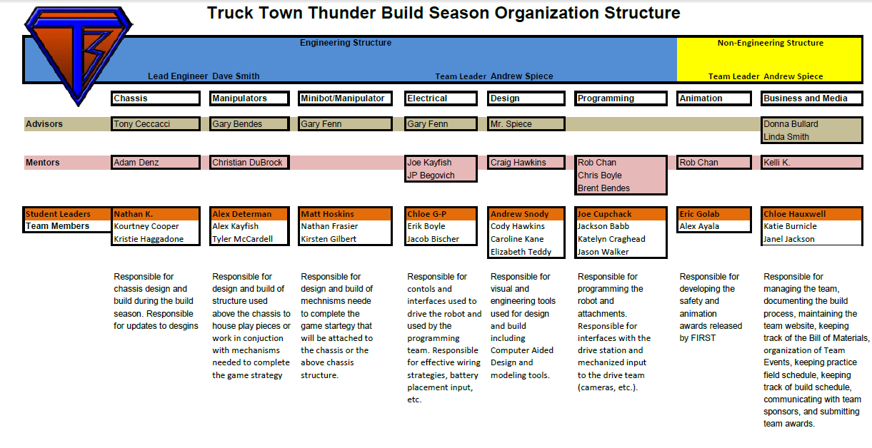
Sub Team Organization/Training
  Sub-Team Assignments
      Technical
        Chassis, Electrical, Manipulators, Etc.
      Managerial
        Awards, Website, Media, Entrepreneurship, Etc
Notes:
“Balanced” – real-world will have to interact between “business” and “technical”…

Slide 25
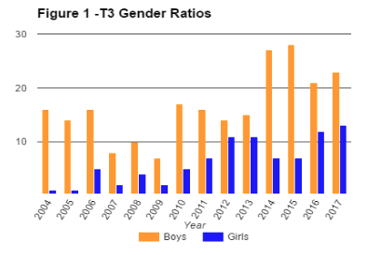
Gender Ratio Over Time

Slide 26
Parent/Robotics Organization (PRO)
Travel Arrangements
Accommodation Arrangements
Fundraising Coordination
Team Spirit
Banquet Arrangements/Coordination
Team Building Activities
Meal Coordination
Camp Coordination
Youth Program Coordination
Notes:
Even if you are not a mentor, parents can help out. More to come on this later…

Slide 27
Questions so far?

Slide 28
Agenda
Welcome
Safety
What is FRC?
T3 History
Team Organization
Code of Conduct
Community Service
Business Details
Turkey Legs
Communications
Split
  Students to Team Building
  Parents here for PRO
Calendar
Close

Slide 29
Code of Conduct
Student Expectations
Student Responsibilities
Be Respectful
Student Recruitment
Team Building
Student Leadership
Spreading the word of FIRST
Giving back to FIRST as an alumni
Positive Attitude
Being Responsible
Maintain a 75% in all classes
Promptness and Attendance
  On time = Late
Turkey Leg shifts
Fundraisers/Sponsorships
Meet Deadlines
Follow Guidelines on Community Service
Check Email Daily
Notes:
29
The Code of Conduct will be gone through thoroughly the First Full Team Meeting with the team.
Grades, attendance, Turkey Legs, Fundraiser/sponsorships, community service
29

Slide 30
Team Calendar
Official Team Calendar
  http://trucktownthunder.com/
  Full Team Meeting = Mandatory
    If you are going to miss a meeting, you must communicate the excused absence form
  Build Sessions
    Read Notes to see who may be needed to attend
    This can vary based on need for the team
Notes:
30

Slide 31
Agenda
Welcome
Safety
What is FRC?
T3 History
Team Organization
Code of Conduct
Community Service
Business Details
Turkey Legs
Communications
Split
  Students to Team Building
  Parents here for PRO
Calendar
Close

Slide 32
Community Service Hours
20 Hours
75% (15) of hours must be a team community service project
  Adopt – A – Road
  Desert Angels
  Mid Michigan Robotics Alliance Events
    Kettering Kickoff – Concession Stand
  Jr. FLL Competition – Brandon Expo
  Mentor FTC/FLL/Jr. FLL Teams
  FTC Qualifier
Hours due prior to Winter Break
Notes:
32
With our Michigan Registration we are allowed to attend 2 district competitions. There may be a chance to get a third district competition. This is done by a lottery conference call with team leaders. We may not know till the last minute. We will post the competition weekend that we will be attempting to attend. The Third District Competition will be mandatory for the competition team (Pits, Drive Team, etc.) to attend but not the full team.
Only 64 teams can qualify for the Michigan State Championships. There are currently approximately 200 teams in Michigan. In order to automatically qualify for the event a team must win a District Chairman's Award. The other teams will be determined by a point system found on the First In Michigan Website. Last year’s Point System is up for viewing on http://firstinmichigan.com/

Slide 33
Agenda
Welcome
Safety
What is FRC?
T3 History
Team Organization
Code of Conduct
Community Service
Business Details
Turkey Legs
Communications
Split
  Students to Team Building
  Parents here for PRO
Calendar
Close

Slide 34
Expenses
Some of our larger expenses
  $15,400 Registration Costs
  $12,000 for Robot Material, Parts, Etc.
  $20,000 in Travel/ Accommodation Costs
  $1000 Public Relations, Buttons, Brochures, Posters, Etc.
  $4500 Food (Team Provided Meals)
  $5000 T-shirts, Uniforms, Etc.
  $8000 Scholarships
Notes:
OK – yeah. We did NOT spend all of the travel costs last year and probably will not this year…

Slide 35
Revenue
$20,000 – Turkey Legs
$19,000 – General Motors
< $5,800 – FCA
$12,000 MDE Grants (Not Confirmed for 2017-2018)
  Some support FTC and FLL teams
$7,000 – Participation Fees
????? - Fundraisers
$5,000 – Partnerships

Slide 36

General Motors Corporation
  Registration = $5000
    2 District Events
  GM Grant = $5,000
  State Champ = $4000
  World Champ = $5000
  Total = $19,000
Notes:
36

Slide 37
FCA (Formerly Chrysler Foundation)
2017 Sponsorship - $5000

Slide 38
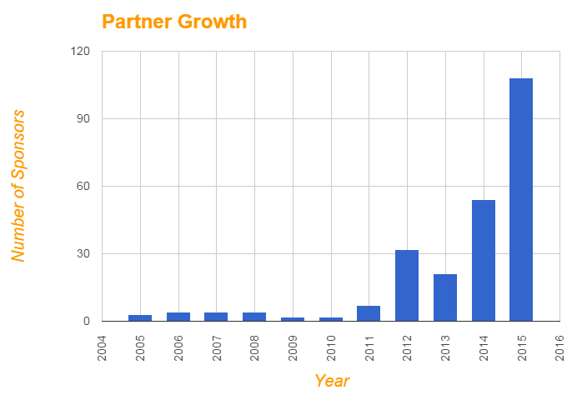
2014-2015 Partners Drive
2015 - 108 Partners
Sorry – we didn’t get this slide updated…
Notes:
38

Slide 39
Fundraising
Student Fundraiser
    $255 per Student plus $200 (in lieu of participation fee)
      Student Executed
      Partnership Drive
        Packet to be handed out at first meeting in September
      Additional options: Restaurant Night, Can Drives, Pancake Breakfasts, Bueche’s Receipts
    September 14,2017 – December 21, 2017
Notes:
39

Slide 40
Overall Team Fees
Fundraiser + Participation Fee = $455
  Scholarship Fund = $250
  Uniforms = $75
  District Accommodations = $50
  Safety Glasses (2 Pair) = $2.50
  Team Meal Supplies = $25
  Team Banquet Costs = $43
  Engineering Notebook = $10
Notes:
We will be working closely with the students to help with this. We are always looking for more ways to help the students with this. We are always balancing the line of having it be executed by the students and helping the students. More information will be shared with the students as we get into September, and first-year students are usually paired with an older student.
Although we prefer Partnerships – AKA sponsorships, alternatives are accepted.
Fundraisers can be as simple as a can drive to organizing a team wide fundraiser such as a haunted barn. Students may also choose to obtain a sponsorship.
It is important that all financial responsibilities are handled before xmas break. This allows for the team to focus solely on the robot building experience. We strongly encourage everyone to be proactive on any issues that come up about the financial obligations to the team. If there is a problem with these fees getting in on team, Please see someone on the advisory board in advance to insure everything gets taken care of.

Slide 41
Team Scholarship Program
$250 per year on team
Must graduate while on team
Reimbursement
Books and Supplies
Notes:
41
Most team members entering a STEM Field have a high probability of getting a scholarship. A majority of our students leave and enter STEM fields. Even putting FIRST on a College Scholarship Applications will help with scholarships acceptance. Visit the FIRST website in order to see what is available.

Slide 42
FIRST Scholarships
$22+ million in college scholarships
Over 746+ individual scholarship opportunities
Over 136+ Scholarship Providers
All scholarship information can be found on the FIRST Website: http://usfirst.org/
Notes:
42

Slide 43
Graduating Seniors
Over the years, T3 Graduating Seniors have received more than $1,250,000.00 in college scholarships
2015 Scholarships totaling $278,595.00
100% Went to College
100% Went into STEM Fields
100% Finished their Freshman Year of College
Notes:
43

Slide 44
Agenda
Welcome
Safety
What is FRC?
T3 History
Team Orgazation
Code of Conduct
Community Service
Business Details
Turkey Legs
Communications
Split
  Students to Team Building
  Parents here for PRO
Calendar
Close

Slide 45
Turkey Legs
Our most important fundraiser…

Slide 46
Fundraising
Renaissance Festival
    Revenue = $20,000
August 12, 2017 at Food Handling/General Orientation
    Time: 10am-12pm
    Mandatory Attendance for New students and family
    Location: Castle (Inside the Festival)
August 19, 2017 – October 1, 2017
    Saturdays, Sunday, and Labor Day
    6:30am – 6:30pm (Approx)
    6 Shifts per Team Member
    Buddy Rule
Notes:
46

Slide 47
Some emphasis reminders…
Wear OLD CLOTHES!
Hats or hairnets!
May want to bring a chair to sit in between loads
WATER BOTTLES (Must have straw to be inside the pad area)
Full day!
Buddy system!!!
Can we get some volunteers to donate cases of water?
  Sign Up to donate water will be on SignUp Genius.
Notes:
47
Thank you Joe for agreeing to help be sure we have oversite every weekend…
Typically at least 4 at each pad, one of which will be an adult, one or more capable of load/unload, and one or more experienced

Slide 48
Questions so far?

Slide 49
Agenda
Welcome
Safety
What is FRC?
T3 History
Team Organization
Code of Conduct
Community Service
Business Details
Turkey Legs
Communications
Split
  Students to Team Building
  Parents here for PRO
Calendar
Close

Slide 50
Team Communication
Official Communications
Unofficial Communications
Email
  Primary Source of Team Communication
  Insures everyone received information
Slack
  Team Documents *
  Sub-Team Communications
Team Website
  Official Team Calendar
  Team Initiatives
Facebook
  Competition Updates
  Robotics Related Posts
Remind App
  Text messages and/or emails
Twitter
  Competition Updates
YouTube Channel
  Competition Updates
  Team Media

Slide 51
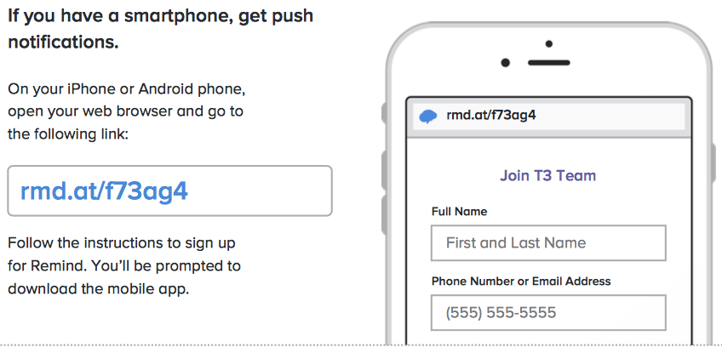
Text Reminders
Smart Phone

Slide 52
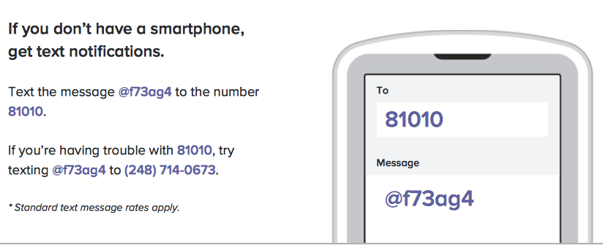
Text Reminders
Don’t have a mobile phone? Go to rmd.at/f73ag4 on a desktop computer to sign up for email notifications.

Slide 53
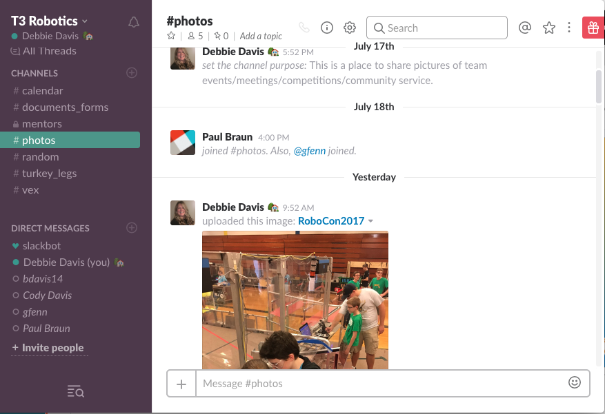
Slack
Slack is our teams "personal" communication space.
It is kind of like Edmodo that many of you have used in school.
This year, all of our team documents will be located in Slack.
This is a great place to bounce ideas off one another during Vex Season.
There is even a "general" area where you can ask team mates homework questions, or general questions about the team or high school.

Slide 54
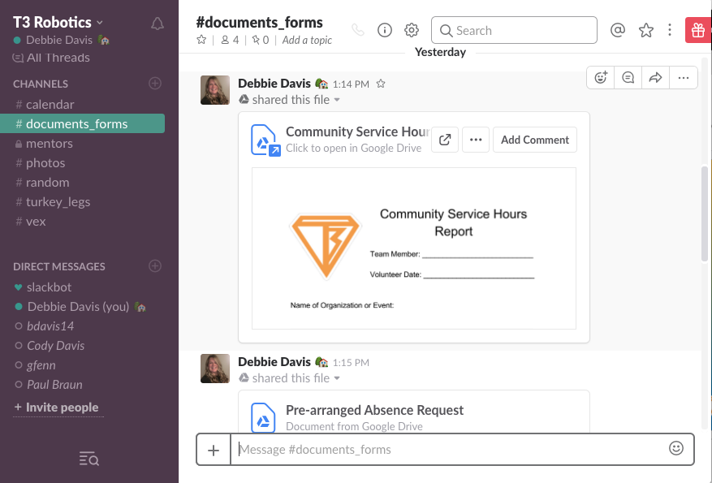
Slack
I will be sending out the email invitation by Wednesday afternoon.
Returning Students
  This is a NEW account so you will need to join under this new invitation.
New Students
  You can access Slack either on an app or from the website on your computer.
Parents
  I am in the process of upgrading our Slack account which will allow me the flexibility to add a parent section. I will send out your invitations as soon as I am able to complete the upgrade.

Slide 55
Homework???
“Like” Truck Town Thunder on Facebook
Take a look at the Team Calendar
  Add it to your phone calendar
  Google Calendar (Recommended)
Be sure you are receiving team emails to your GMAIL Account
All students will be required to have a @gmail.com account this year.

Slide 56
Questions so far?

Slide 57
Agenda
Welcome
Safety
What is FRC?
T3 History
Team Organization
Code of Conduct
Community Service
Business Details
Turkey Legs
Communications
Split
  Students to Team Building
  Parents here for PRO
Calendar
Close

Slide 58
Break Time!
Mr. Fenn gets to work with the students on a team building activity or two….
Parents please stay seated

Slide 59
“Robot 101” support
Students need to be trained…
  Returning students need refreshers and “skill expansion”
  New students need the basics
Please let Mrs. Davis and Mr. Fenn know which meetings we can count on you attending.

Slide 60
Truck Town Thunder Robotics
Parent Resource Organization - PRO
  The PRO helps the team by
      Team Meals
      Partnership Acquisition
      Participate with Community Service Projects
      End of Year Banquet
      Holiday Party
Notes:
60
Team Mission: Our mission is to inspire young people to be science and technology leaders, by engaging them in exciting mentor-based programs that build Science, Technology, Engineering and Mathematics skills that inspire innovation, and that foster well rounded life capabilities including self-confidence, communication, and leadership.

Slide 61
Truck Town Thunder Robotics
Administrative Items
    Student Medical Form
    Parent Transportation Form
    Turkey Leg Sign Up – Cindy Hawkins
  Other PRO items
    Bloomfield Hills All-Girls Robotics Competition
Notes:
61
Contact information: We will sending all communications via email and not sending notes home with the students. Anything sent home with your student will require some sort of signature.
Student Medical Form: This is required in order for us to have information while we are at an event, fundraiser, etc. We will also have medical forms available for medications to be given at events, etc.
The school has a Driver Waiver Form that must be filled out in order to transport students for the team.
If you come across any community service ideas, please sign up what it is. We are also looking for people to organize some of these events.
Please take a moment to sign up for Turkey legs before you leave. Each Team member is required to fulfill 8 Turkey leg shifts.

Slide 62
Bloomfield Hills All-Girls Robotics Competition
    T3 is a Co-Host
    We will need
      Help transporting students on Friday to set up for event
      Help with concession stand
        This includes ordering pizza's to be delivered to event to sell at lunch as well as help to shop for concession stand items.

Slide 63
Questions so far?

Slide 64
…time for the students to come back…

Slide 65
Agenda
Welcome
Safety
What is FRC?
T3 history
Team Org
Code of conduct
Community service
Business details
Turkey Legs
Communications
Split
  Students to Team Building
  Parents here for PRO
Calendar
Close

Slide 66
July and August Calendar
Heller demo (July 29)
Library demo (Aug 7)
GM Powertrain Family day (August 11)
Turkey Leg training – August 12 10 AM
Turkey Legs every weekend starting August 19

Slide 67
Students aren’t QUITE “Robotics-less” the rest of the summer
Watch for an eMail in the next week or so for “self study” opportunities
It’s taken longer than we thought – and less complete – than we wanted it to be…

Slide 68
Team Calendar
September,
  Full Team Meetings – Every other week
October
    Full Team Meetings - Once a week (Thursdays)
    Online Training – (TBD)
November and December
  Full Team Meetings – Twice a week
  VEX competition(s)
Team Outreach
Team Fundraising

Slide 69
VEX Robotics
Team Members gain training with a competitive robotics goal in mind
More students gain experience with direct hands on with robots
Learn Robotics Basics with state of the art curriculum
Robotics Skills Challenges
Curriculum Developed by mentors of World Class Robotics Teams
Adjusting our methods to use this as a “growth” opportunity – VEX sub-team leaders are future “sub-team leaders in training”
Notes:
69
Gather my thoguhts on changing the “makeup” of VEX, it’s now “JV”…

Slide 70
Bloomfield Hills All-Girls Robotics Competition
    T3 is a Co-Host
    As in the past, help set up and we will run the concession stand
    Proceeds to support scholarships
    Boys can’t touch the robot after pits are set up! (They get to run concessions and cheer the girls on!)

Slide 71
Future Calendar

Slide 72
T3 - The Build Cycle
January 6, 2018 – Official FIRST Kickoff
  First Saturday
  Location: Brandon ITEC Center (tentative)
  Broadcasted on NASA Channel
  Tentative Agenda
      Gathering, Kickoff - 9am – 12pm
      Lunch - 12pm-1pm
      Rules Analysis/ Kit Inventory/ Strategizing - 1pm-5pm

Slide 73
T3 - The Build Cycle Cont.
First Week
    Strategy Decisions, Design Decisions, Prototyping
    Monday to continue brainstorming, sorting parts
    Meet every night the first week
2nd week until ship date
    We will have Full Team meetings Tuesday, Thursday and Saturday Through Competition Season (5-9pm)
      Calendar will be posted online
    Build Sessions Monday, Wednesday, and Friday (6-9pm)
      Team Member must attend 2 out of 3 each week
      Based on Sub-team Assignments
      Stay Tuned to some small adjustments to attendance policy this year
Notes:
Build Sessions are done this way in order for students to use this time for studies, tests, and have some flexibility in their schedule. We will also have scheduled study time after school as well in order for students to keep up with their school work. It is important that students utilize this time. Though meetings are scheduled to end at 9, this is not always possible. We must remember that we are working very hard to meet this deadline and not every meeting cleanup will go as smoothly as we would like. We strive to get out of there by 9pm but we do realize that there are situations where a meeting may run passed 9pm. We would like to bring this up now so that parents may plan accordingly. According to the clock in the shop, we had one meeting go to 9:15 last year but most meetings were never more than about 5 minutes past 9. We will continue to work hard to get out at 9. We also need to get home to our families and will be trying to get home as well.

Slide 74
2018 Competition Schedule
Michigan Districts
    March and Early April - 2 Districts (Will try to get 3)
    Pit Setup Thursday Nights
    Compete Friday and Saturday
    Student Activities Absence for Friday classes
    We will not travel for more than one district
Michigan State Championships/Regional
    Assumed Saginaw Valley State University
    Must Qualify to attend
    http://firstinmichigan.org/
    Student Activities Absence for Thursday and Friday Classes. (Spring Break?)
Notes:
74
Tentitve dates April 11-14 for states. Does not fall during spring break

Slide 75
2018 Competition Schedule
World Championships
    Apr 25 - Apr 28 2018
    Detroit MI – Ford Field
    New venue – schedule TBD as we get closer
    Student must follow Code of Conduct while traveling
  Team Must Qualify to Attend

Slide 76
Off Season Events
Team will attend all off-season events they are invited too.
  Michigan Advanced Robotics Competitions – Late June
  Indiana Robotics Invitational – July
  Kettering Kickoff – September
  Bloomfield Girls Robotics Competition – November (Host)
Notes:
since we were in the Middle of “hiring new management” we were unable To attend off season events this year.

Slide 77
Questions so far?

Slide 78
Agenda
Welcome
Safety
What is FRC?
T3 history
Team Org
Code of conduct
Community service
Business details
Turkey Legs
Communications
Split
  Students to Team Building
  Parents here for PRO
Calendar
Close

Slide 79
Closing
This material will be posted on the T3 website shortly
Please feel free to contact Debbie or Gary
  debluvs2teach@gmail.com gary.r.fenn@gm.com
  810-449-6171 586-623-2879
  248-214-8574
Finally…
  We close our meetings a certain way… who’s taking us out?

